Slide 1


P.E.S. COLLEGE OF ENGINEERING
MANDYA
Department of Information Science and Engineering
Presentation on
“DEEP LEARNING-BASED TUBERCULOSIS DETECTION USING CHEST RADIOGRAPHS”
Presentation by:
Arun Kumar 4PS22IS007
Deekshith A 4PS22IS015
Dhanush AM 4PS22IS017 Vishwabandhu KN 4PS22IS059
Dept. of Information Science and Engineering P.E.S.C.E, Mandya
Under the Guidance of:
Dr. T.S Prabhakar
Associate Professor & HOD,
Dept of Information Science and Engineering
PESCE, Mandya
Department of Information Science and Engineering

Slide 2
INTRODUCTION
Department of Information Science and Engineering

Slide 3
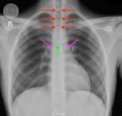
INTRODUCTION
Tuberculosis (TB) is an infectious disease caused by the bacterium Mycobacterium tuberculosis, mainly affecting the lungs.
TB spreads through airborne droplets when an infected person coughs, sneezes, or speaks.
According to the WHO, around 10.8 million people developed TB globally in 2023.
TB caused approximately 1.25 million deaths worldwide, making it one of the leading infectious killers.
India has the highest TB burden, contributing nearly 26–27% of global TB cases.
Department of Information Science and Engineering

Slide 4
PROBLEM IDENTIFICATION
There is a severe shortage of expert radiologists in low-resource regions.
Existing AI systems rely on computationally heavy lung segmentation.
Errors during lung segmentation propagate and cause incorrect classifications.
Medical imaging datasets suffer from severe class imbalance.
Standard data augmentation fails to generate diverse pathological patterns.
Imbalanced data biases models toward the "normal" class, causing dangerous false negatives.
Department of Information Science and Engineering

Slide 5
LITERATURE
REVIEW
Department of Information Science and Engineering

Slide 6
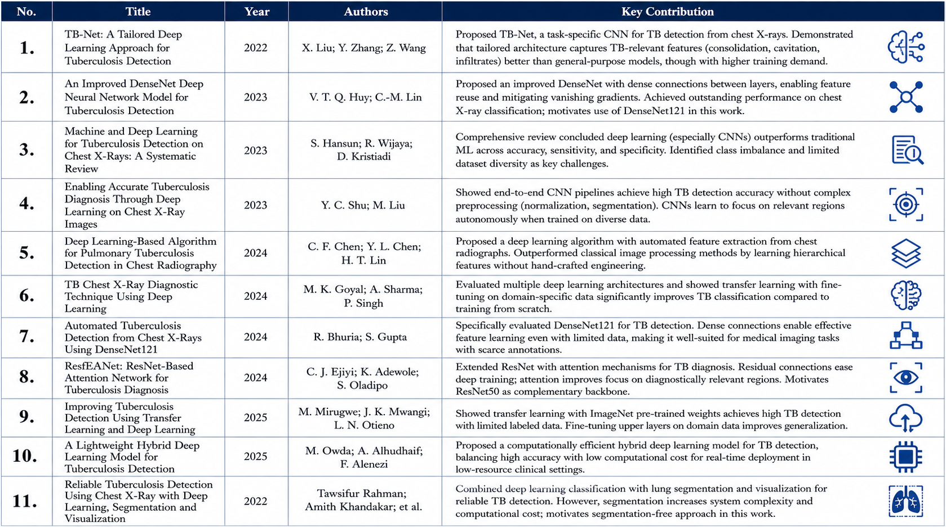
Department of Information Science and Engineering

Slide 7
SUMMARY OF LITERATURE REVIEW
Segmentation-Free Pipeline: Eliminates complex lung segmentation preprocessing to reduce computational overhead and prevent multi-stage error propagation.
GAN-Based Augmentation: Synthesizes high-quality, genuine-looking chest X-rays to explicitly balance the dataset and resolve minority class limitations.
Pathological Diversity: Generates unique, distinct disease features beyond standard geometric flips and rotations to vastly improve model generalization.
Ensemble Majority Voting: Integrates multiple diverse model predictions to drastically minimize false negatives and ensure a highly reliable clinical diagnosis.
Department of Information Science and Engineering

Slide 8
OBJECTIVES
Department of Information Science and Engineering

Slide 9
OBJECTIVE - 1
Prepare the Data and Create Synthetic Images
Collect dataset: Gather chest X-ray images and classify them into TB-positive and normal categories.
Preprocess images: Resize and enhance X-rays for consistent quality and better analysis.
Generate synthetic data: Use GANs to create realistic artificial TB chest X-ray images.
Balance dataset: Add generated images to overcome class imbalance and improve model learning.
Department of Information Science and Engineering

Slide 10
OBJECTIVE - 2
Train the Deep Learning Models
Train AI models: Use DenseNet121 and ResNet50 to detect TB from chest
X-rays.
Apply transfer learning: Use pre-trained knowledge to improve learning
speed and performance.
Compare training methods: Test models with normal and synthetic
datasets find the best approach.
Evaluate performance: Measure accuracy, precision, and detection
effectiveness.
Department of Information Science and Engineering

Slide 11
OBJECTIVE - 3
Combine Models for a Final Vote and Evaluate
Build ensemble voting: Combine trained models using a majority voting system.
Improve reliability: Use voting to reduce individual model errors.
Minimize false negatives: Ensure TB cases are not incorrectly classified as healthy.
Enable real-world use: Recommend deployment in hospitals and clinics with limited experts.
Department of Information Science and Engineering

Slide 12
OBJECTIVE - 4
Develop the User Interface and Connect the System
Develop user interface: Create a simple web application for X-ray image uploads.
Build backend system: Connect uploaded images to trained deep learning models.
Show instant results: Display TB-positive or normal predictions clearly.
Optimize for deployment: Ensure fast and lightweight performance for clinic use.
Department of Information Science and Engineering

Slide 13
METHODOLOGY
Department of Information Science and Engineering

Slide 14
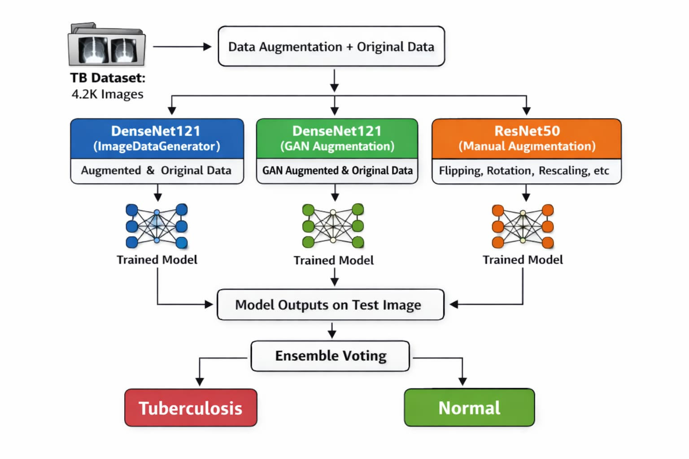
METHODOLOGY
Department of Information Science and Engineering

Slide 15
METHODOLOGY
Data Preparation & Augmentation Strategy
Deep learning pipeline: Detect TB from chest X-rays without lung segmentation.
Dataset preparation: Use 4,200 NIH chest X-ray images with 70% train, 15% validation, and 15% test split.
Image preprocessing: Apply resizing and pixel normalization for consistency.
Data augmentation: Use rotation, flipping, scaling, and shifting techniques.
GAN-based synthesis: Generate synthetic TB images to solve class imbalance.
Department of Information Science and Engineering

Slide 16
METHODOLOGY
Model Architecture & Ensemble Voting
Transfer learning: Initialize DenseNet121 and ResNet50 with pre-trained ImageNet weights.
Train multiple models: Evaluate standard and GAN-augmented model configurations.
Ensemble voting: Use majority voting from three models for final prediction.
Improve diagnosis: Reduce false negatives and achieve 98.91% accuracy.
Department of Information Science and Engineering

Slide 17
DATASET
Department of Information Science and Engineering

Slide 18

DATASET
The NIH Chest X-ray Dataset is a large public medical imaging dataset developed by the National Institutes of Health containing thousands of chest X-ray images.
CLICK HERE
Department of Information Science and Engineering

Slide 19
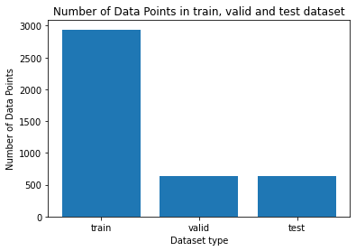
DATASET SPLITING
Department of Information Science and Engineering

Slide 20
OUTPUTS FROM MODEL TRAINING
Department of Information Science and Engineering

Slide 21
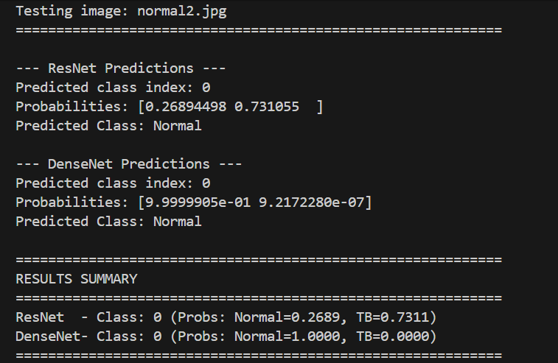
OUTPUT FOR NORMAL CLASS
Department of Information Science and Engineering

Slide 22
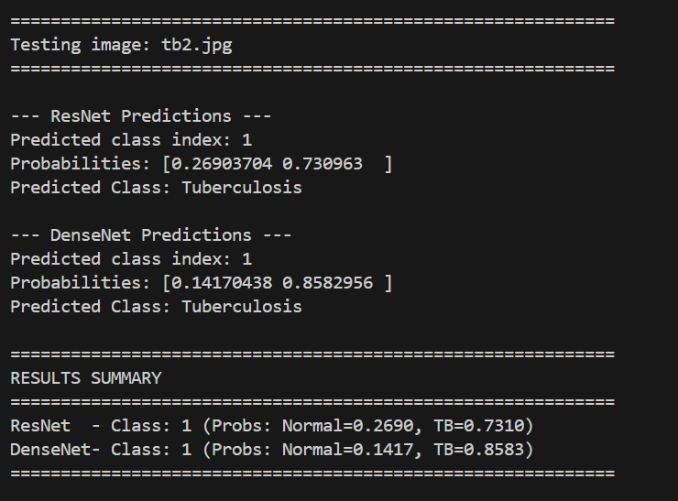
OUTPUT FOR TUBERCOLOSIS POSITIVE
Department of Information Science and Engineering

Slide 23
EVALUATION OF MODEL
Department of Information Science and Engineering

Slide 24
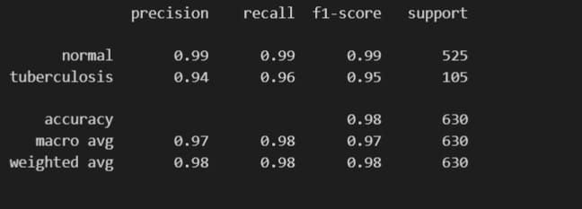
EVALUATION OF MODEL
DENSENET121 CLASSIFICATION REPORT
Department of Information Science and Engineering

Slide 25
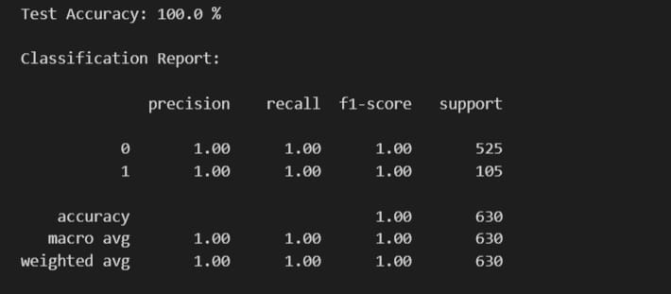
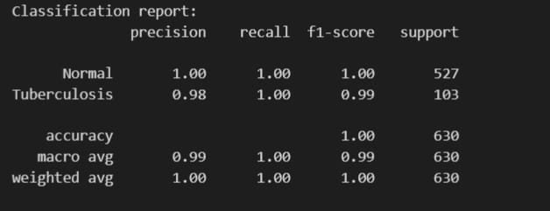
EVALUATION OF MODEL
DENSNET121 + GAN CLASSIFICATION REPORT
RESNET 50 CLASSIFICATION REPORT
Department of Information Science and Engineering

Slide 26
SNAPSHOTS OF APPLICATION
Department of Information Science and Engineering

Slide 27
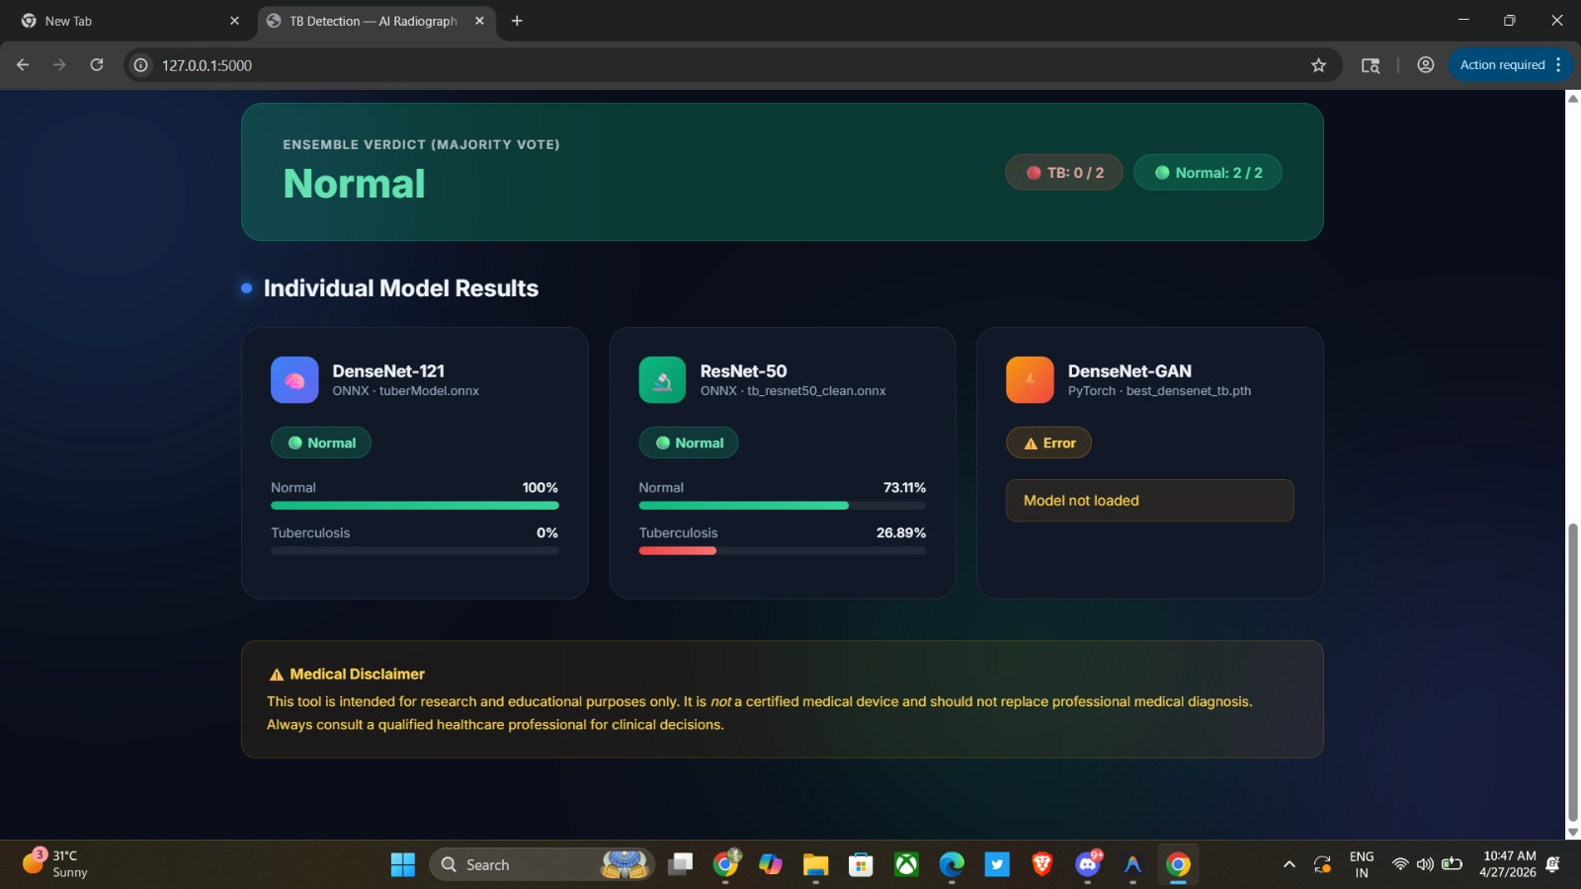
SNAPSHOT
Department of Information Science and Engineering

Slide 28
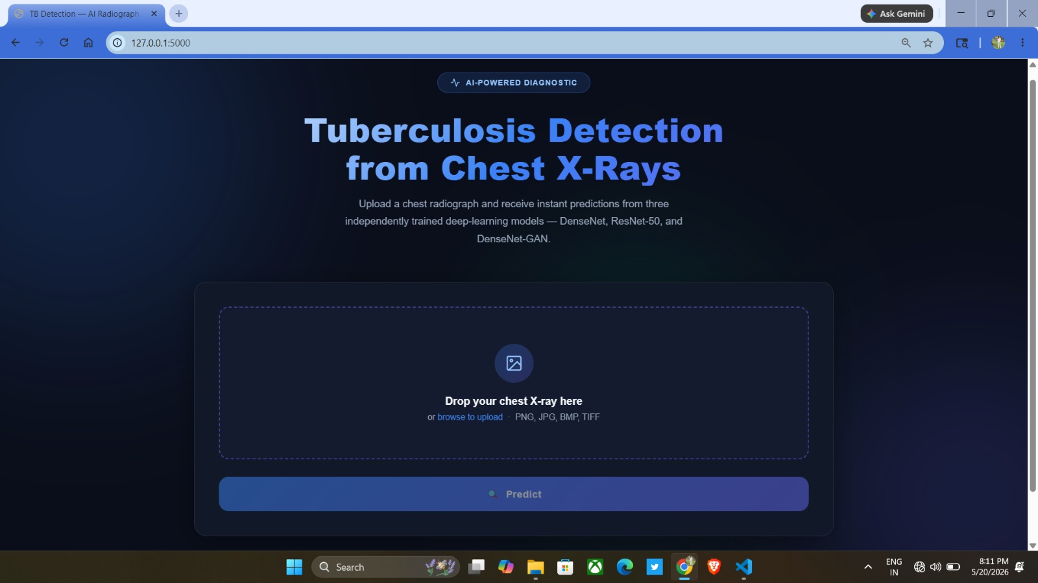
SNAPSHOT
Department of Information Science and Engineering

Slide 29
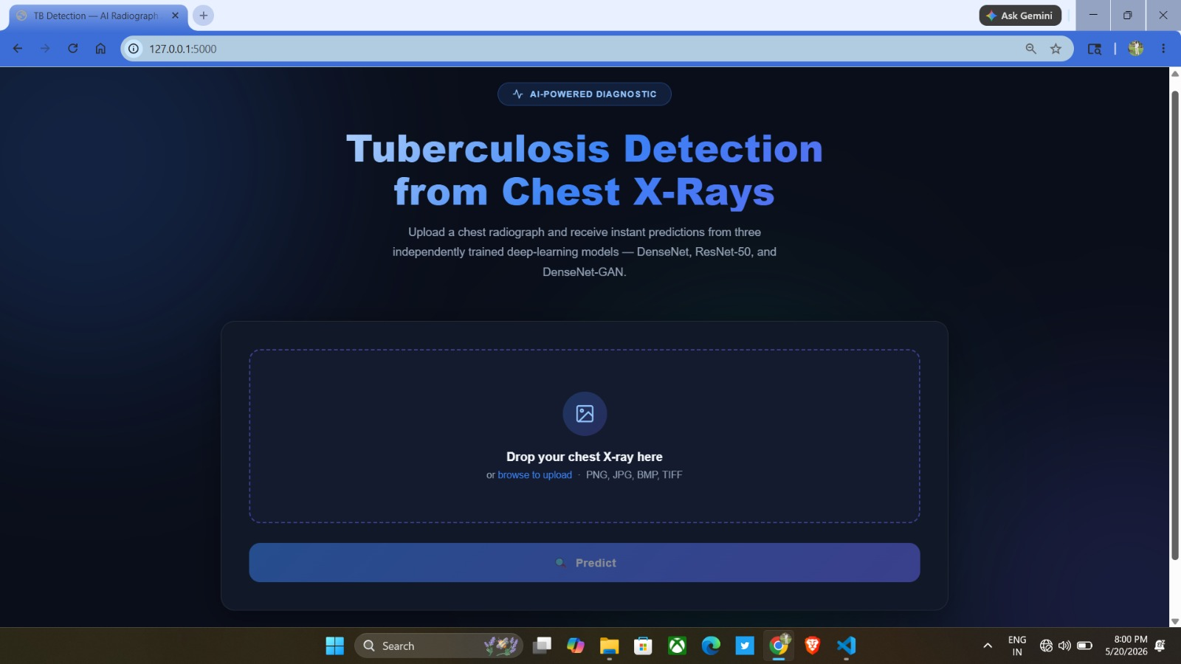
SNAPSHOT
Department of Information Science and Engineering

Slide 30
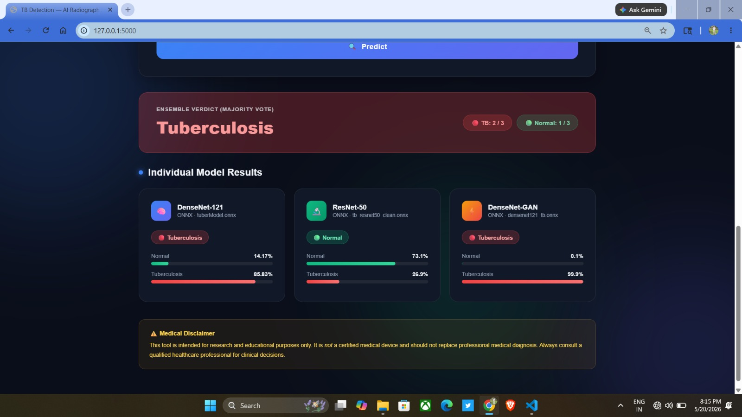
SNAPSHOT
Department of Information Science and Engineering

Slide 31
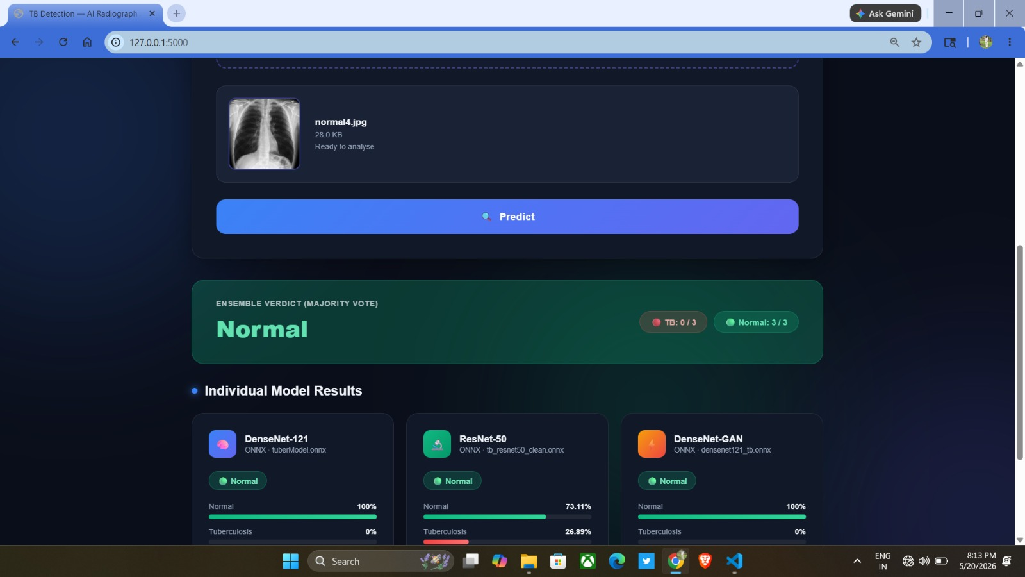
SNAPSHOT
Department of Information Science and Engineering

Slide 32
CO-PO MAPPING
Department of Information Science and Engineering

Slide 33
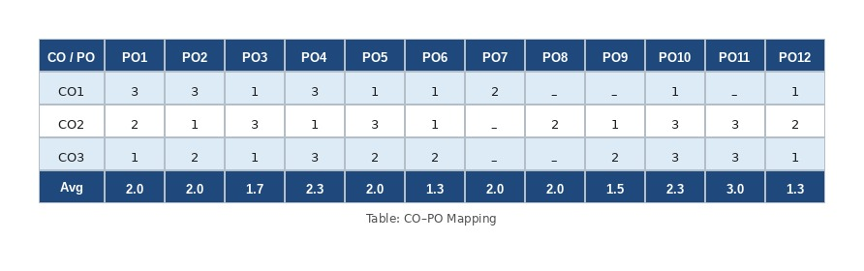
CO-PO MAPPING
Department of Information Science and Engineering

Slide 34
FUTURE SCOPE
Department of Information Science and Engineering

Slide 35
FUTURE SCOPE
Multi-center validation: Test on datasets from multiple hospitals worldwide.
Conditional GANs: Generate specific TB types for better rare case detection.
Clinical evaluation: Test on real hospital patient data.
Explainable AI: Use Grad-CAM to highlight affected X-ray regions.
Multi-disease detection: Expand to classify TB, pneumonia, COVID-19, and lung cancer.
Federated learning: Train across hospitals while preserving patient privacy.
Department of Information Science and Engineering

Slide 36
CONCLUSION
Department of Information Science and Engineering

Slide 37
CONCLUSION
This work presents an automated Tuberculosis (TB) detection system using chest X-ray images and deep learning techniques. By integrating transfer learning with DenseNet121 and ResNet50, GAN-based data augmentation, and an ensemble majority voting approach, the system achieved high detection performance while reducing false negatives. The use of synthetic image generation successfully addressed class imbalance and improved model reliability. Additionally, eliminating lung segmentation reduced computational complexity, making the framework efficient and practical for real-world deployment. Overall, the proposed approach demonstrates strong potential for supporting early TB screening, particularly in resource-limited healthcare environments.
Department of Information Science and Engineering

Slide 38
THANK YOU
Department of Information Science and Engineering

